Slide 1
WEEKLY METRICS
Metrics are numbers that tell's the important information about a process.
This shows the accurate count about how the process is functioning and provide base for you to suggest improvement.
In weekly metrics we capture every tickets of past week and organize them accordingly in excel.
Our environment we are tracking the process from Sunday to Monday.

Slide 2
Steps:
Create a rule in service now for Incident, RITM and change request.
Run 3 rules separately and get the data.
Download the data in the form of excel.
Copy the data and add those three data in a single excel sheet.
Make a count of each based on category.

Slide 3
Rule in service Now
For getting the past One Week report( Monday to Sunday) we need to create a rule in service now for Incident, RITM and Change Request.
Open service now, search View/Run
Table – INCIDENT
Assignment group – Both Platform and Application
Between – Past Monday to Sunday
Click on Run.

Slide 4
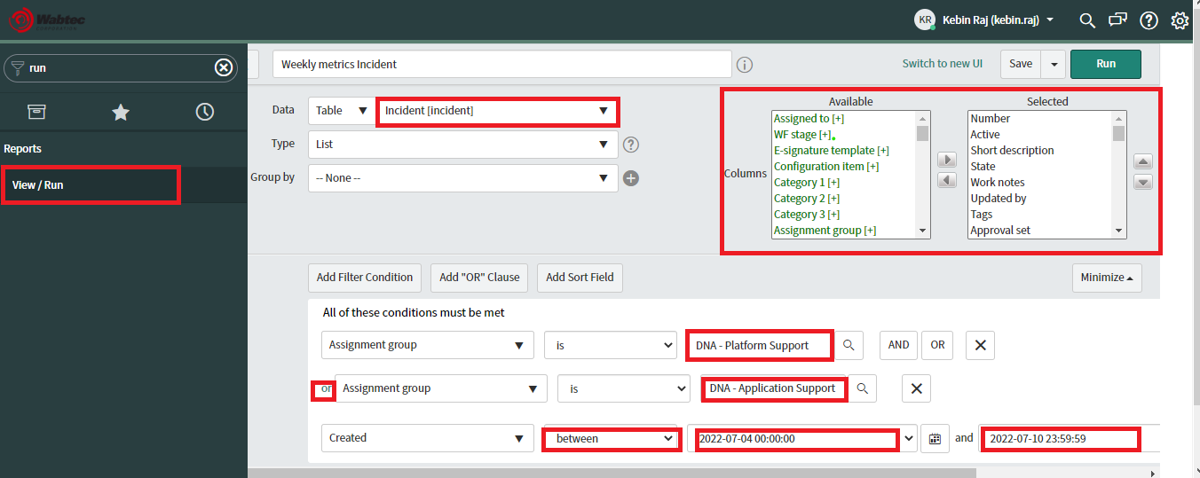

Slide 5
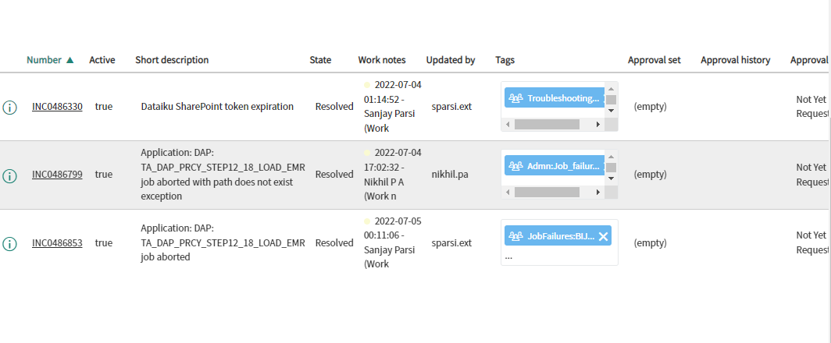
Once Run we will get a report for the past selected dates. Following image shows the output.

Slide 6
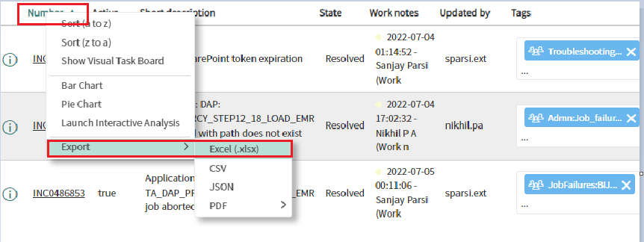
Download in form of Excel:

Slide 7
Same process we need to do for both RITM and Change Request to get the past One Week Report.
After getting all the 3 reports, We need to open the mail and search for the previous week report which we send.
In that excel sheet, we need to remove the old report.
After removing, need to copy paste the latest report which we downloaded.

Slide 8
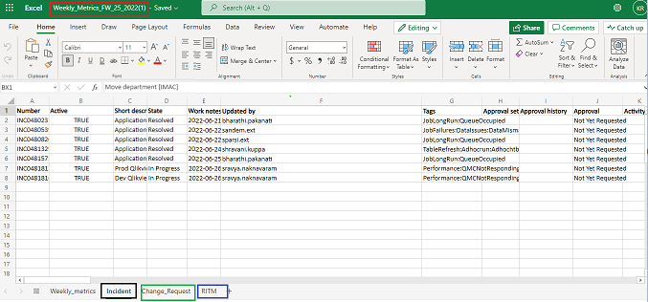
Excel sheet:

Slide 9
Excel name should be mentioned like in the above screenshot, followed with the current forward week. (Ex: FW_26)
We need to add the copied report in the respective sheets like Incident or RITM or Change Request.
After this 3 sheets copied. Need to count each sheet exact numbers. Also sub – categories like : Maintenance, Rebuild, Platform, Application and Qlikview.
Also need to give the exact count of tickets which we got on respective applications.

Slide 10
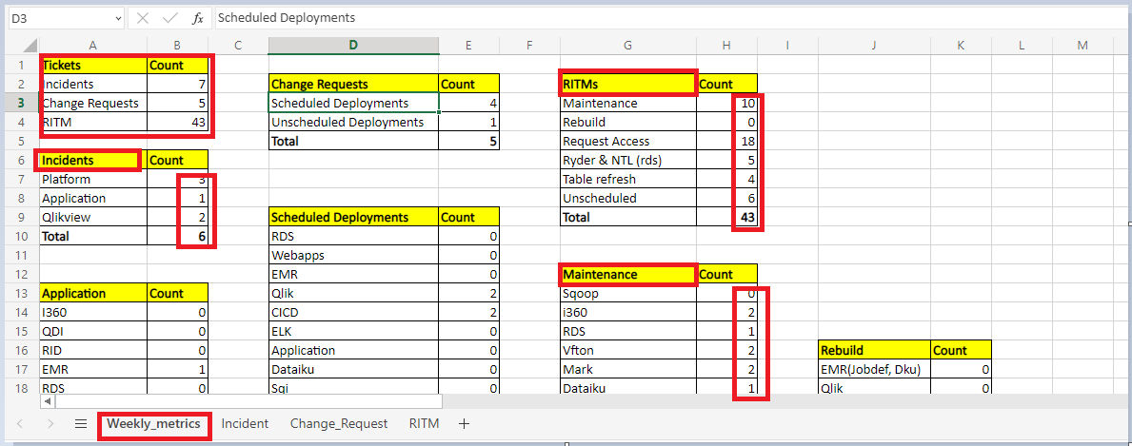
Weekly Metrics – Count:

Slide 11
Every Monday we need to prepare this report and send it with the exact count of tickets which we got in the past one week.
Thank you

